Slide 1
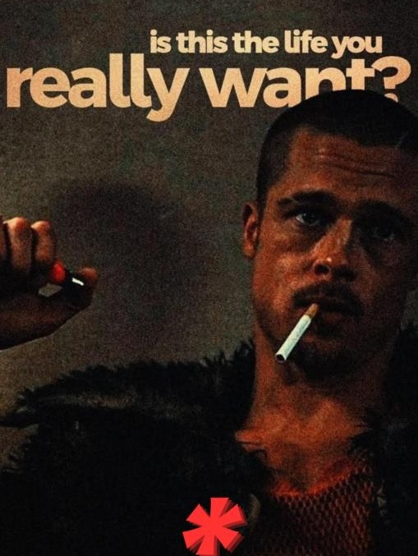

YOUR ROOM
DOESN'T NEED
TO BE PERMANENT.
FOR PEOPLE WHO RENT,
NOT OWN.
Lowkey Livin
Design-led décor for Bengaluru's Gen Z renters.

Slide 2

01 — THE PROBLEM
02
Renting is temporary. Identity isn't.
A renter can’t renovate the room — but they still want it to feel like theirs.
01
02
03
NO PERMANENCE
NO FIT
NO MIDDLE
PGs, hostels & first apartments are temporary.
Mass décor is generic. Premium décor is priced for owners.
There is no obvious brand built around the young renter.
THE GAP
Affordable × opinionated × renter-first
LOWKEY LIVIN
02

Slide 3
02 — THE INSIGHT
The room is temporary.
The self-expression isn't.
That changes what people will buy.
LOW COMMITMENT
HIGH SIGNAL
LOW PRICE FRICTION
No paint. No drilling.
No landlord approval.
The product should say
something about you.
₹999 feels like a purchase,
not a project.
LOWKEY LIVIN
03

Slide 4
03 — THE SOLUTION
04
A drop-based décor brand built around renter behaviour.
Instead of an endless catalogue, Lowkey Livin creates small, opinionated drops that feel scarce, relevant and easy to buy.
01
02
03
04
CURATE
DROP
CONVERT
LEARN
Strong point of view
Small-batch releases
Accessible entry price
Feedback → next drop
THE PRODUCT SYSTEM
A3 canvases → home objects → new categories
FROM ₹999
LOWKEY LIVIN
04

Slide 5

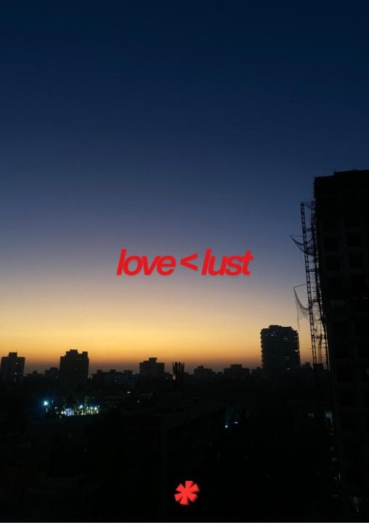
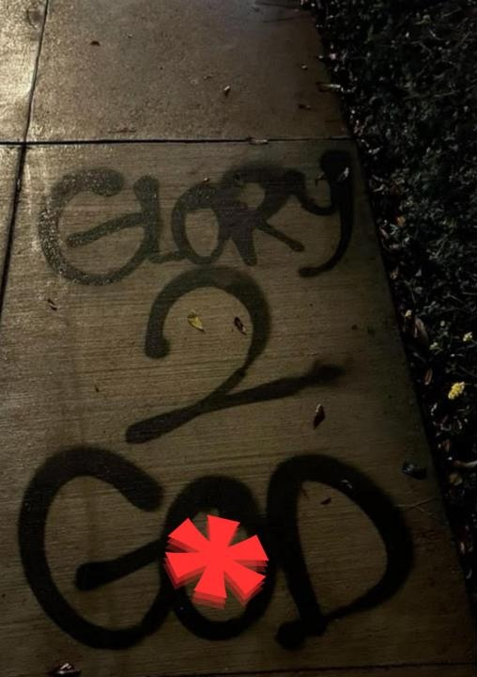
04 — THE PRODUCT
Products are the proof.
The brand is the story.
A3 CANVAS PRINTS
11 designs
₹999
297×420mm · printed on demand
HOME OBJECT
Framed wall mirror
from ₹1,650 · 2 square sizes
LOWKEY LIVIN
05

Slide 6
05 — WHY NOW
06
Bengaluru is a city of renters.
The customer is arriving faster than traditional décor brands are adapting.
~4L
25–40%
₹999
new working professionals move to Bengaluru
reported YoY rise in Bengaluru PG rents
Lowkey Livin canvas entry point
Directional estimate from the source deck
Directional indicator from the source deck
Low-friction purchase inside a move-in budget
THE OPPORTUNITY
Make temporary rooms feel personal — at the price of an impulse purchase.
LOWKEY LIVIN
06

Slide 7
06 — COMPETITION
We don't want to be the biggest.
We want to be the most relevant.
GENERIC
Premium interiors
OUR LANE
OPINIONATED
LIMITED
RENTER-FIRST
ACCESSIBLE
LOWKEY LIVIN
Amazon / mass décor
OPINIONATED
LOW PRICE
HIGH PRICE
LOWKEY LIVIN
07

Slide 8
07 — BUSINESS MODEL
08
Simple economics. Controlled risk.
The model is intentionally designed to keep fixed inventory and operating complexity low.
D2C
DEMAND-LED
Own the customer relationship and brand experience.
Print canvases on demand; make mirror variants to order.
CITY DENSITY
COMMUNITY
Win Bengaluru before expanding geography.
Use discovery + direct feedback to shape the next drop.
Working capital goes into the next drop — not unsold stock.
LOWKEY LIVIN
08

Slide 9
08 — TRACTION
Already live. Now we scale what works.
13
12
2
1
pieces live
SKUs
sales channels
city
DEMAND LOOP
DISCOVER
EXPERIENCE
RETURN
CONVERT
Instagram + design reveals
Flea markets + real feedback
WhatsApp + next-drop access
D2C purchase
The next proof point is repeat purchase — not more SKUs.
LOWKEY LIVIN
09

Slide 10
09 — WHAT'S NEXT
10
The next 12 months are about proving repeatability.
1
2
3
REPEAT
EXPAND
DISTRIBUTE
More drops per quarter + stronger repeat purchase.
A second product category beyond canvases and mirrors.
Explore hostel / PG partnerships and B2B bulk orders.
WHAT WE NEED FROM THIS ROOM
Challenge the model. Pressure-test the price. Open doors to the next customer.
LOWKEY LIVIN
10

Slide 11
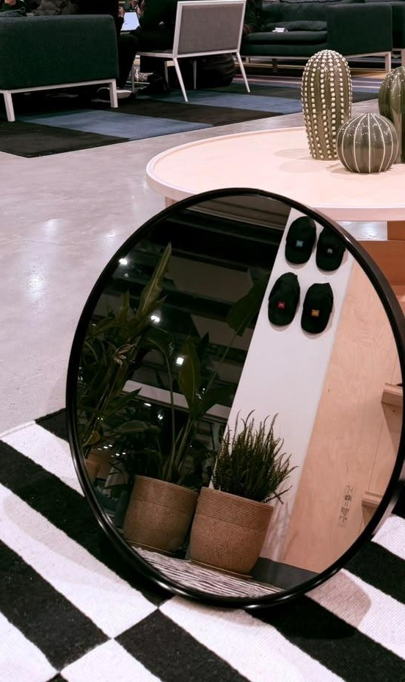
THE GO-TO FIRST-ROOM DROP
FOR EVERY RENTER IN BENGALURU.
Make the room temporary.
Make the identity permanent.
lowkeylivin.in · @lowkeylivin.store
THANK YOU
LOWKEY LIVIN
11

